Slide 1
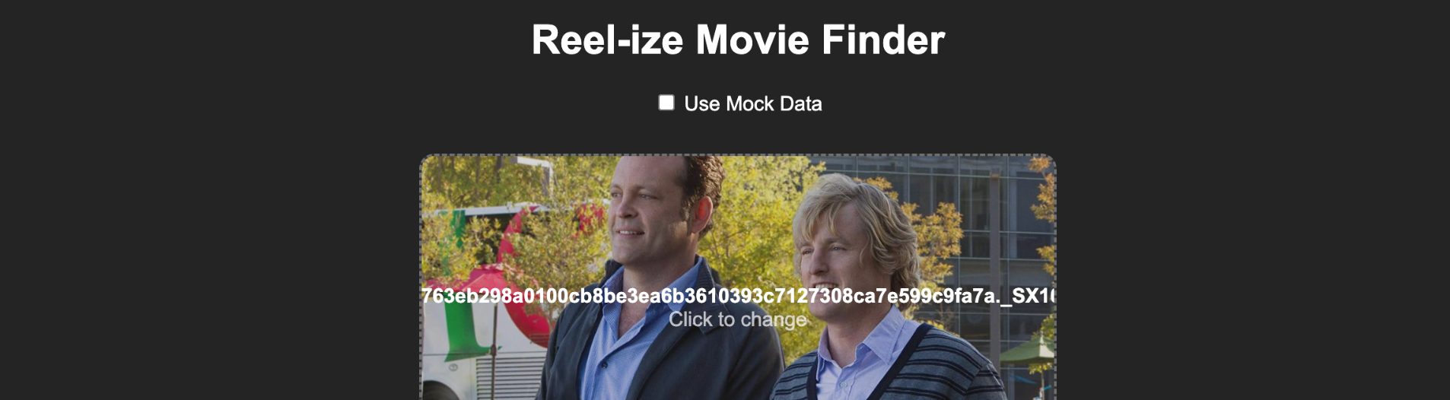
Final Presentation
Reelize Movie Finder
Myles, Dillon, Ivie, Max
Machine Learning Course Project
Notes:
Myles

Slide 2
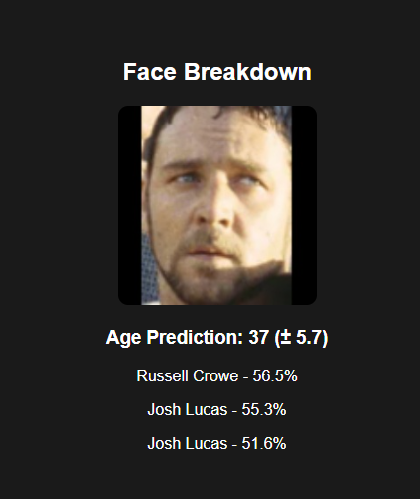
Outline
1 Project Overview 2 Face Model
3 Age Model
4 Demo
5 Project Debrief
Reel-ize: Movie Finder
Outline
Notes:
Myles

Slide 3

Project Overview
1
2
3
4
Face Model
Predict each actor’s name based on the image.
Input
Search TMDB
Display Results
User inputs a still image from a movie
Find the movie based on the results of the models
Display on the UI what the distributions are and what the movie predictions are.
2
Age Model
Predict each actor’s age based on the image
Reel-ize: Movie Finder
Project Overview
Notes:
Myles

Slide 4

Face Model

Slide 5
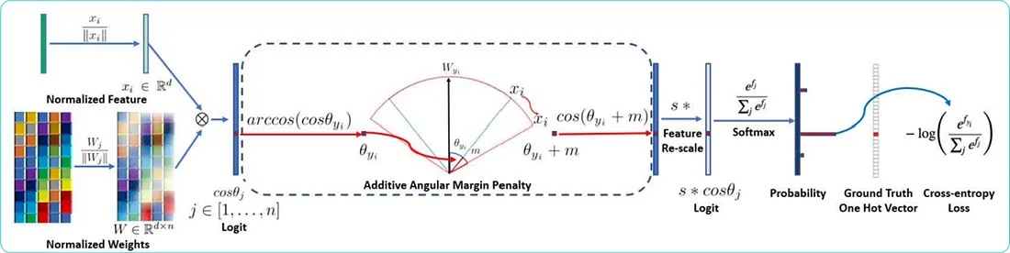
ArcFace
Face Recognition and ArcFace: Additive Angular Margin Loss for Deep Face Recognition
Medium
Reel-ize: Movie Finder
Face Model
Notes:
Dillon

Slide 6
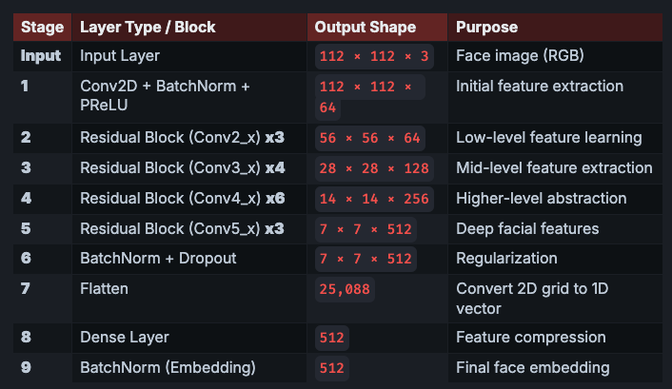
ResNet34 Breakdown
ArcFace
ArcFace Utilizes an Residual Network, a special case of CNNs
Layer skipping is what makes a ResNet special
In each “Residual Block” the initial input is added to the output of that block, helping to solve the loss of data or Vanishing Gradient Problem present in large CNNs
The output of the ResNet is a 512 dimension embedding, which is passed into a post-processing algorithm
Reel-ize: Movie Finder
Face Model
Notes:
Dillon

Slide 7
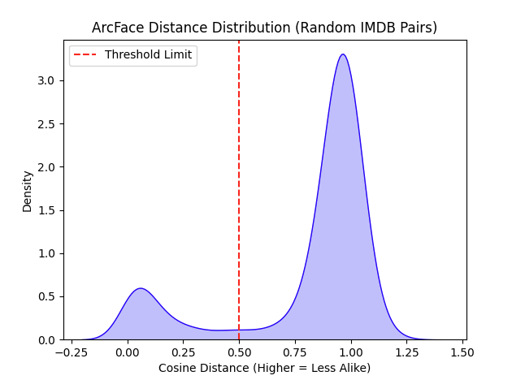
Distance Threshold Breakdown
ArcFace
20,000 random images were chosen and compared against eachother using ArcFace and Cosine Distance
0.0 - The number of true matches
1.0 - Completely Different
0.5 - Is the Threshold Limit chosen between completely different and exactly the same.
This threshold value means that the images below a 0.5 distance will be accepted as a potential match, and images 0.5 and above will be rejected because they are too distant from eachother to be considered a match
Reel-ize: Movie Finder
Face Model
Notes:
Myles

Slide 8
Age
Model
Notes:
Max

Slide 9
Age
Experimenting with Different Backbones
Number | CNN Backbone | Testing Average MAE
1 | EfficientNetB0 (Original) [4.4m params] | ~6.6
2 | EfficientNetB4 [17.6m params] | ~6.4
3 | Xception [20.8m params] | ~5.9
4 | ResNetV250 [23.8m params] | ~5.7
Reel-ize: Movie Finder
Age Model
Notes:
max

Slide 10
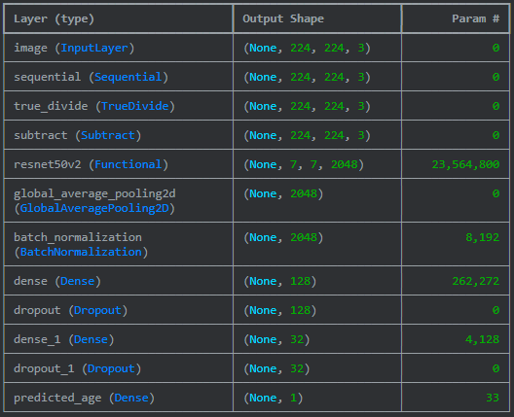
Age Model Architecture
50,000 images (80/20 split)
CNN with pretrained model
ResNetV2-50
Trainable params: 270,529 (last 40 layers unfrozen
CNN Head
Global Average Pooling and Batch Normalization layers
2x 0.25 dropout layers
128 → 32 → 1 dense layers
Loss Function: Huber
Optimizer: Adam
Early Stopping and Model Checkpoints
Reel-ize: Movie Finder
Age Model
Notes:
max

Slide 11
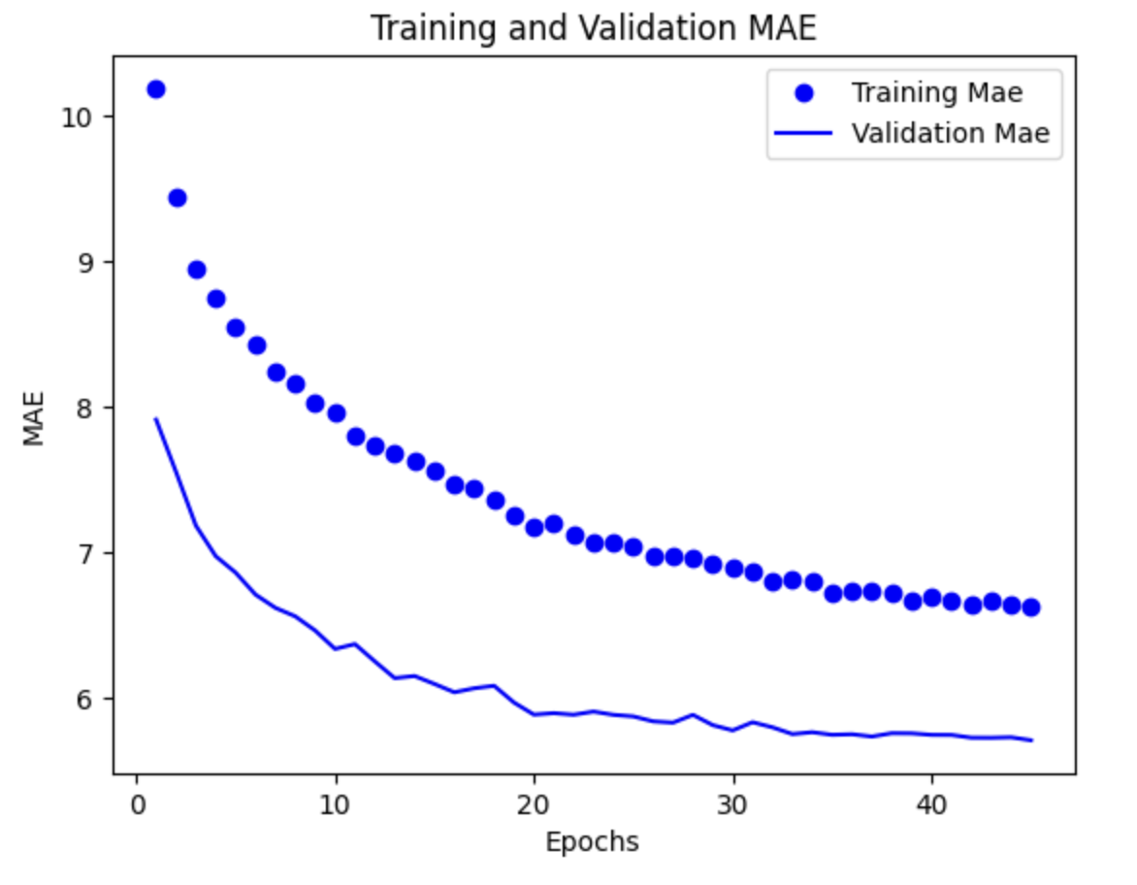
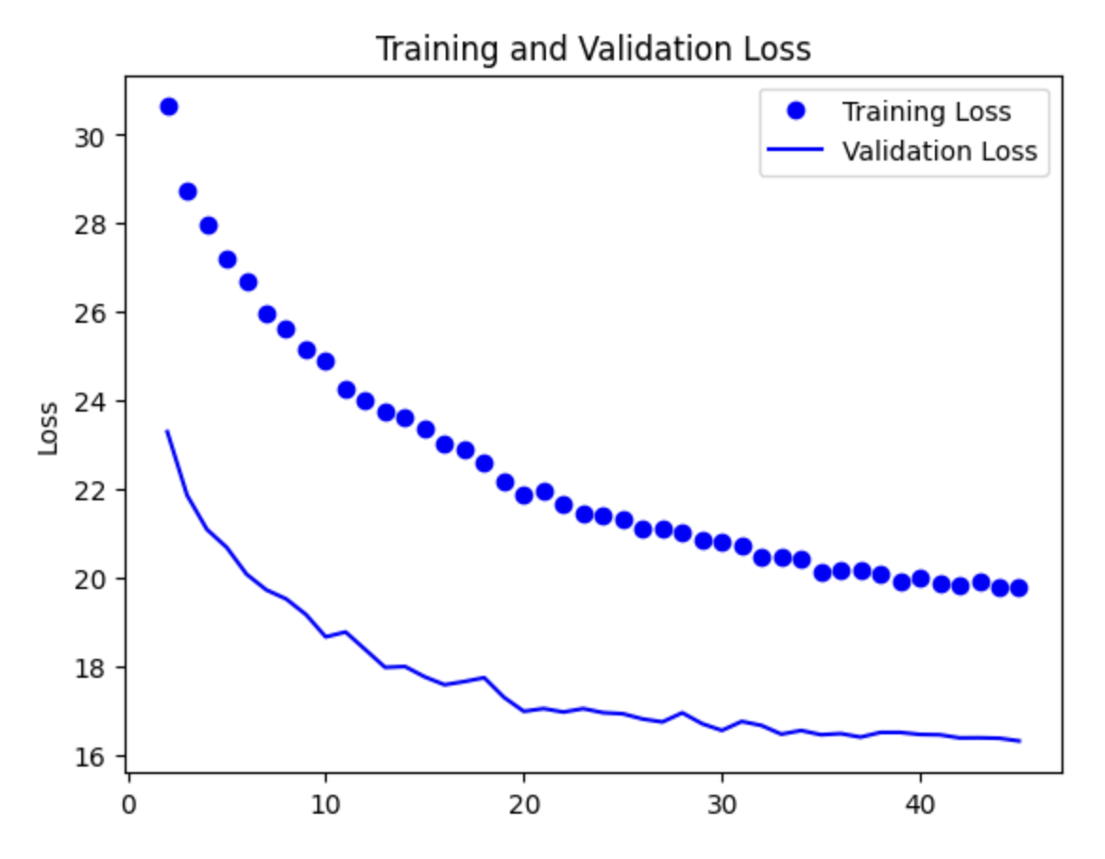
Age
Model Results
2 Stages of Model Training
Stage 1 - Training only CNN Head (30 epochs
Stage 2 - Fine-tuning head with partly unfrozen backbone (45 epochs)
With ResNetV250, able to get test MAE to around ~5.70.
data augmentation applied (flip, rotate, zoom)
Non-weighted sampling
No overfitting/underfitting in training. Potentially ~200 epochs to see overfitting.
Reel-ize: Movie Finder
Age Model
Notes:
Ivie
Just train dense layers for training the head
Partly unfreeze the backbone to fine tune
Not overfitting, but we didn’t have time to try 200 epochs for training
10 hours of training for our current model
We see the gap because of dropout and data augmentation, so validation will be better

Slide 12
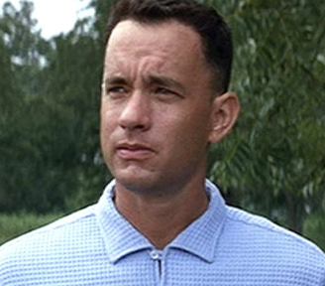
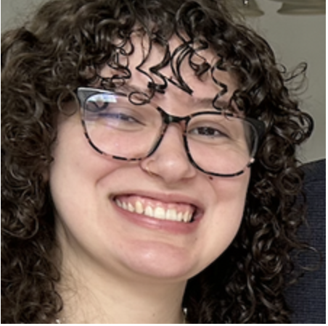
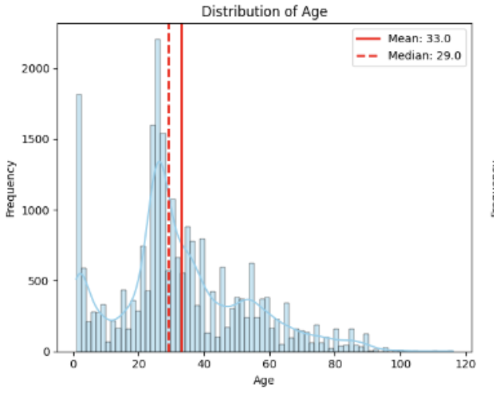
Age
Model Examples
Film Still
Non-Film Still
Predicted: 33
Actual: 37
Difference: |+4| < 5.7
Predicted: 45
Actual: 20
Difference: |-25| >> 5.7
Reel-ize: Movie Finder
Age Model
Notes:
Ivie Images are from film, and they do a bit better at predicting the age.
Most likely cuz of the type of lightings and such in film

Slide 13
Demo
Link Here
Notes:
Max

Slide 14
Project Debrief
Notes:
Ivie

Slide 15
What went
General communication and team response times
Getting a functional model with somewhat accurate results
Training the model
Getting our query algorithms to work
Overall latency not face based
Well?
Reel-ize: Movie Finder
Project Debrief
Notes:
Ivie

Slide 16
What could be
Model Accuracy
Face Model
Side profiles
less popular actors
Quality of data wasn’t great
Age Model
Data augmentation and datasets didn’t help
Uneven age ranges
Latency could be better
Better?
Reel-ize: Movie Finder
Project Debrief
Notes:
Ivie

Slide 17
Back to Demo
Link Here
Notes:
Max

Slide 18

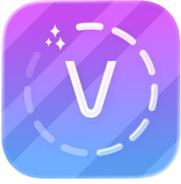
Next
Steps
Look for other models or a different approach
Similar products just query ChatGPT or other LLMs
Change models entirely
Look for better datasets
Some UI Improvements/Quality of Life
Similar Products
ClipFix
Voola
Reel-ize: Movie Finder
Project Debrief
Notes:
Dillon

Slide 19
Thank You
Notes:
Dillon

